Slide 1
A clear vision of Tea
Prepared by Sai Ganesh Reddy Buthukuri

Slide 2
Chemical compositions:
Physically speaking, tea has properties of both a solution and a suspension. It is a solution of all the water-soluble compounds that have been extracted from the tea leaves, such as the polyphenols and amino acids, but is a suspension when all of the insoluble components are considered, such as the cellulose in the tea leaves.
Caffeine constitutes about 3% of tea's dry weight, translating to between 30 and 90 milligrams per 250-millilitre (8+¹⁄₂ US fl oz) cup depending on the type, brand, and brewing method.A study found that the caffeine content of one gram of black tea ranged from 22–28 mg, while the caffeine content of one gram of green tea ranged from 11–20 mg, reflecting a significant difference.Tea also contains small amounts of theobromine and theophylline, which are stimulants, and xanthines similar to caffeine.
Black and green teas contain no essential nutrients in significant amounts, with the exception of the dietary mineral manganese, at 0.5 mg per cup or 26% of the Reference Daily Intake (RDI).Fluoride is sometimes present in tea; certain types of "brick tea", made from old leaves and stems, have the highest levels, enough to pose a health risk if much tea is drunk, which has been attributed to high levels of fluoride in soils, acidic soils, and long brewing.
The astringency in tea can be attributed to the presence of polyphenols. These are the most abundant compounds in tea leaves, making up 30–40% of their composition.Polyphenols include flavonoids, epigallocatechin gallate (EGCG), and other catechins.Although there has been preliminary clinical research on whether green or black teas may protect against various human diseases, there is no evidence that tea polyphenols have any effect on health or lowering disease risk

Slide 3
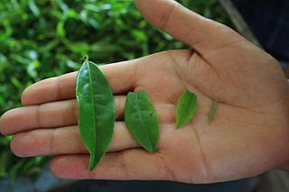
Fresh tea leaves in various stages of growth:

Slide 4
Tea processing:
Tea is generally divided into categories based on how it is processed. At least six different types are produced:
White: wilted and unoxidized;
Yellow: unwilted and unoxidized but allowed to yellow;
Green: unwilted and unoxidized;
Oolong: wilted, bruised, and partially oxidized;
Black: wilted, sometimes crushed, and fully oxidized (called 紅茶 [hóngchá], "red tea" in Chinese and other East Asian tea culture);
Post-fermented (Dark): green tea that has been allowed to ferment/compost (called Pu'er if from the Yunnan district of South-Western China or 黑茶 [hēichá] "black tea" in Chinese tea culture).
After picking, the leaves of C. sinensis soon begin to wilt and oxidize unless immediately dried. An enzymatic oxidation process triggered by the plant's intracellular enzymes causes the leaves to turn progressively darker as their chlorophyll breaks down and tannins are released. This darkening is stopped at a predetermined stage by heating, which deactivates the enzymes responsible. In the production of black teas, halting by heating is carried out simultaneously with drying. Without careful moisture and temperature control during manufacture and packaging, growth of undesired molds and bacteria may make tea unfit for consumption.

Slide 5
Additional processing and additives
After basic processing, teas may be altered through additional processing steps before being sold and is often consumed with additions to the basic tea leaf and water added during preparation or drinking. Examples of additional processing steps that occur before tea is sold are blending, flavouring, scenting, and decaffeination of teas. Examples of additions added at the point of consumption include milk, sugar and lemon.
Tea blending is the combination of different teas together to achieve the final product. Such teas may combine others from the same cultivation area or several different ones. The aim is to obtain consistency, better taste, higher price, or some combination of the three.
Flavoured and scented teas add aromas and flavours to the base tea. This can be accomplished through directly adding flavouring agents, such as ginger, cloves, mint leaves, cardamom, bergamot (found in Earl Grey), vanilla, and spearmint. Alternatively, because tea easily retains odours, it can be placed in proximity to an aromatic ingredient to absorb its aroma, as in traditional jasmine tea.

Slide 6
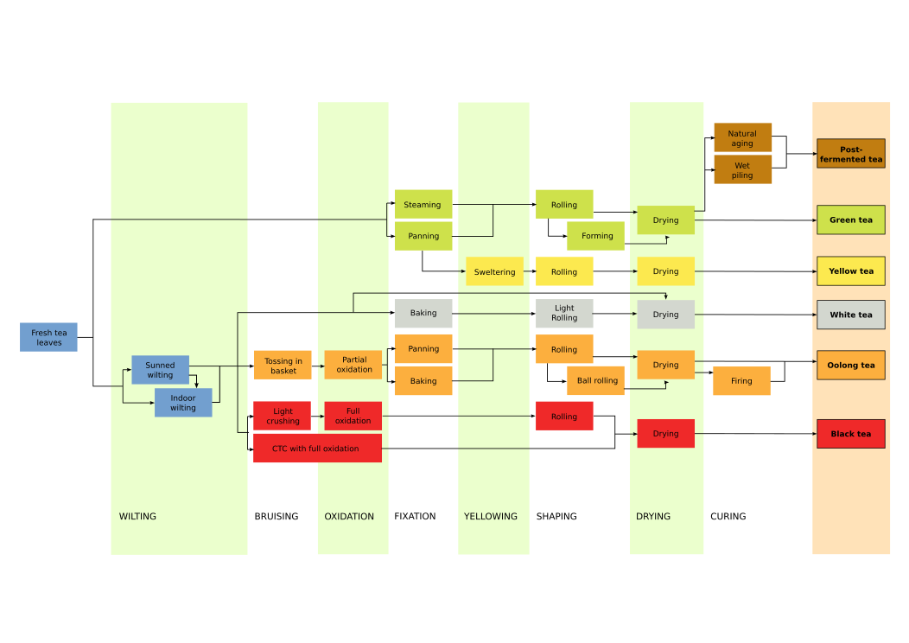
Additional processing and additives[cont] Common processing methods of tea leaves

Slide 7
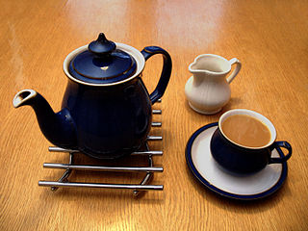
Additional processing and additives[cont] Black tea is often taken with milk

Slide 8
Additional processing and additives[cont]
The addition of milk to tea in Europe was first mentioned in 1680 by the epistolist Madame de Sévigné. Many teas are traditionally drunk with milk in cultures where dairy products are consumed. These include Indian masala chai and British tea blends. These teas tend to be very hearty varieties of black tea which can be tasted through the milk, such as Assams, or the East Friesian blend. Milk is thought to neutralise remaining tannins and reduce acidity. The Han Chinese do not usually drink milk with tea but the Manchus do, and the elite of the Qing Dynasty of the Chinese Empire continued to do so. Hong Kong-style milk tea is based on British habits. Tibetans and other Himalayan peoples traditionally drink tea with milk or yak butter and salt. In Eastern European countries, Russia and Italy, tea is commonly served with lemon juice. In Poland, tea is traditionally served with a slice of lemon and is sweetened with either sugar or honey; tea with milk is called a bawarka ("Bavarian style") in Polish and is also widely popular. In Australia, tea with milk is known as "white tea".
The order of steps in preparing a cup of tea is a much-debated topic and can vary widely between cultures or even individuals. Some say it is preferable to add the milk to the cup before the tea, as the high temperature of freshly brewed tea can denature the proteins found in fresh milk, similar to the change in taste of UHT milk, resulting in an inferior-tasting beverage. Others insist it is better to add the milk to the cup after the tea, as black tea is often brewed as close to boiling as possible. The addition of milk chills the beverage during the crucial brewing phase, if brewing in a cup rather than using a pot, meaning the delicate flavour of a good tea cannot be fully appreciated. By adding the milk afterwards, it is easier to dissolve sugar in the tea and also to ensure the desired amount of milk is added, as the colour of the tea can be observed. Historically, the order of steps was taken as an indication of class: only those wealthy enough to afford good-quality porcelain would be confident of its being able to cope with being exposed to boiling water unadulterated with milk. Higher temperature difference means faster heat transfer, so the earlier milk is added, the slower the drink cools. A 2007 study published in the European Heart Journal found certain beneficial effects of tea may be lost through the addition of milk.

Slide 9
Thank you

